Slide 2
Review
3
UNIT 7 – 8 – 9
LESSON 1: SKILLS
Reading
Speaking & Listening
Writing
Unit

Slide 3
OBJECTIVES
By the end of the lesson, students will be able to:
practice on the vocabulary items and grammar points Ss have already studied and the skills they have practised in Units 7,8,9.

Slide 4
LESSON 2: SKILLS
WARM-UP
Chatting
READING
Task 1: Read the passage. Match the headings in the box with the paragraphs.
Task 2: Read the passage again and answer the questions.
Task 3: Interview your group members. Take notes of their answers and report to the class.
Task 4: Listen to Trang talking about watching films with her family. Fill in each blank with ONE word.
SPEAKING &
LISTENING
Task 5: Write a paragraph of about 70 words about your favourite means of transport. You may use the following questions as cues.
WRITING
CONSOLIDATION
Wrap-up
Home work

Slide 5
LESSON 2: SKILLS
Chatting
WARM-UP
Aims of the stage:
To increase students’ interest and lead them into the lesson.
FESTIVALS
Notes:
Wordwall link to spin the wheel in real time: https://wordwall.net/resource/27022823

Slide 6
LESSON 2: SKILLS
WARM-UP
Chatting
READING
Task 1: Read the passage. Match the headings in the box with the paragraphs.
Task 2: Read the passage again and answer the questions.

Slide 7
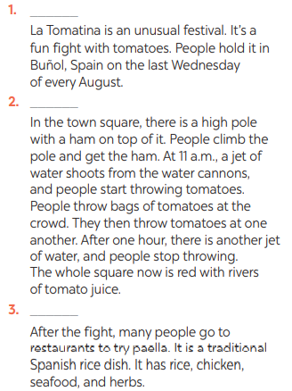
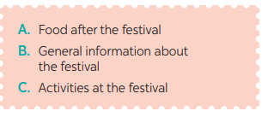
READING
1
Read the passage. Match the headings in the box with the paragraphs.
B
C
A

Slide 8
READING
2
Read the passage again and answer the questions.
1. When and where do people hold La Tomatina?
2. What is on the top of the pole?
3. What signals the start and end of the festival?
4. How long is the fight?
5. What is paella?
→ People hold it in Buñol, Spain on the last
Wednesday of every August.
→ There is a ham.
→ A jet of water from the water cannons.
→ It’s one hour
→ It’s a traditional Spanish rice dish.

Slide 9
LESSON 2: SKILLS
WARM-UP
Chatting
READING
Task 1: Read the passage. Match the headings in the box with the paragraphs.
Task 2: Read the passage again and answer the questions.
Task 3: Interview your group members. Take notes of their answers and report to the class.
Task 4: Listen to Trang talking about watching films with her family. Fill in each blank with ONE word.
SPEAKING &
LISTENING

Slide 10
SPEAKING & LISTENING
3
Interview your group members. Take notes of their answers and report to the class.
Questions | S1 | S2 | S3
1. How far is it from your house to your school?
2. How do you go to school?
3. What is good about walking?
4. What is good about public transport?
Aim of the task:
To help students practise asking about Traffic

Slide 11
SPEAKING & LISTENING
Listen to Trang talking about watching films with her family. Fill in each blank with ONE word.
4
Aim of the task:
To help stu-dents practise listening for specific infor-mation (gap-filling).
home
relationship
time
lessons
language

Slide 12
LESSON 2: SKILLS
WARM-UP
Chatting
READING
Task 1: Read the passage. Match the headings in the box with the paragraphs.
Task 2: Read the passage again and answer the questions.
Task 3: Interview your group members. Take notes of their answers and report to the class.
Task 4: Listen to Trang talking about watching films with her family. Fill in each blank with ONE word.
SPEAKING &
LISTENING
Task 5: Write a paragraph of about 70 words about your favourite means of transport. You may use the following questions as cues.
WRITING
CONSOLIDATION
Wrap-up
Home work

Slide 13
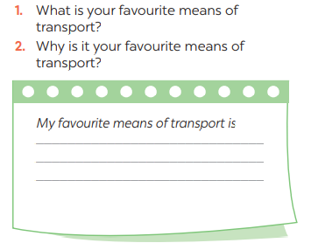
WRITING
5
Write a paragraph of about 70 words about your favourite means of transport. You may use the following questions as cues.
Aim of the task:
To help students write a paragraph describing a visit to a holiday city, based on the information provided.

Slide 14
CONSOLIDATION
1
WRAP-UP
Reading
Speaking & Listening
Writing

Slide 15
CONSOLIDATION
2
HOMEWORK
Prepare for the next lesson: Unit 10 – Getting started

